Slide 1

TEAM 11
PROJECT PROPOSAL

Slide 2
Contents
1
TEAM INFORMATION
2
PROGRAM DESCRIPTION
3
PROJECT MILESTONE
3
GitHub ADDRESS

Slide 3
Part 1
TEAM INFORMATION

Slide 4




Part 1
TEAM INFORMATION
TEAM 11
Park Jong Ho
2nd Grade
Computer Science
Libin Joseph
4th Grade
Computer Science

Slide 5
Part 2
PROGRAM DESCRIPTION

Slide 6
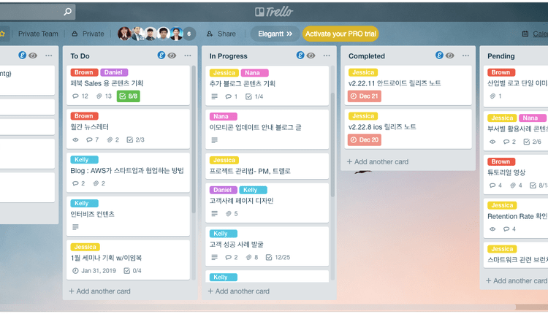
PROGRAM DESCRIPTION
Part 2
PROGRAM TOPIC
Lirello
Linux+Trello
Work Management PROGRAM runs like a Trello
Based on Text First, implement GUI if we can
PROGRAM interacts with Server Client

Slide 7

PROGRAM DESCRIPTION
Part 2
VISUAL CONCEPT – LOGIN PHASE
WELCOME TO LIRELLO!!
You can type your existing ID here
ID:
You can type your existing PW here
You can type ‘R’ or click to Register
PW:
You can type ‘L’ or click to Login
Register
Login

Slide 8
PROGRAM DESCRIPTION
Part 2
VISUAL CONCEPT – PROJECT MAKE PHASE
Print Existing page, you can choose existing project by type ‘e’ or click
EXISTING PROJECT
EXISTING PROJECT2
You can add project
By type ‘a’ or click
You can delete existing project by type ‘d’ or click
ADD
DELETE

Slide 9
PROGRAM DESCRIPTION
Part 2
VISUAL CONCEPT
TASK BLOCK
You can see Online person here user status bar
PROJECT NAME
SCHEDULE
TO DO
DOING
DONE
PARK
JOSEPH
SCHEDULE BLOCK
TO DO BLOCK
DOING BLOCK
DONE BLOCK
ANONYMOUS
You can add new task block by type ‘a’ or click
You can delete existing task block by type ‘d’ or click
ADD
DELETE

Slide 10
PROGRAM DESCRIPTION
Part 2
FUNCTIONALITIES
Register
You can type ID and PASSWORD
If you type existing ID, print ‘ID is duplicated’
Login
You can type ID and PASSWORD you typed in Register
Compare ID and PW with server data, if incorrect, print ‘ID or password is incorrect’
PROJECT MAKE
You can type ‘a’ to add a new project
You can type ‘d’ to delete a project
TASK BLOCK
You can add Task Block, delete Task Block by type or click
Task block can be shown to every online users
If you type specific character, TO DO BLOCK change to DOING BLOCK, also DOING BLOCK to DONE BLOCK
You can add your comment under the TASK BLOCK
USER STATUS BAR
Print user`s name who is on your project
Green circle means user is online, Red circle means user is offline

Slide 11
PROGRAM DESCRIPTION
Part 2
Warnings
Program can be changed due to our programming skill and schedule

Slide 12
Part 3
PROJECT MILESTONE

Slide 13
Part 3
PROJECT MILESTONE
Task | Weekly Milestone
 | Nov 1 2 3 4 |  |  |  | Dec 1 2 3 4
Planning and deciding features that can be implemented based on the time
Make a basic communication between client and server using sockets for a group
Add database so that the data can be stored in a file
Add cards feature in the terminal
Add commenting functionality for users
GUI for the entire app (Based on the amount of time left)

Slide 14
Part 4
GitHub ADDRESS

Slide 15

Part 4
Github Address
http://github.com/sysprogramming/sysproj

Slide 16
TEAM 11`s PROPOSAL
Thank You

